Slide 1

Goldbach’s Conjecture Analysis
Author: Tuan Bui
Stony brook university
AMS 325

Slide 2
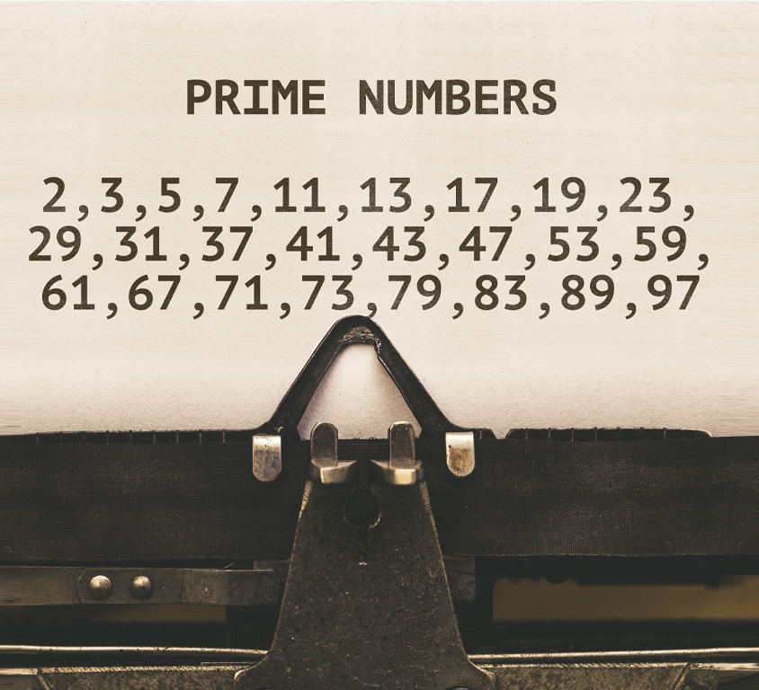
Prime Numbers
A whole number greater than 1 whose only factors are 1 and itself.

Slide 3
Sieve of Eratosthenes
An ancient algorithm for finding all prime numbers up to any given limit.
Iteratively mark all multiples of each prime number, starting with the first prime number, 2.
The remaining unmarked numbers are primes.
Sieve of Eratosthenes animation

Slide 4


Sieve of Eratosthenes
Proof:
Suppose a positive integer $n$ is not prime, then $n$ is composite.
Call: $n=ab$, for some integers $a,b$ with $1<a≤b$.
Assume $a>\sqrt{n},$then $ab≥a^{2}>n$, a contradiction.
Hence, the statement holds by contradiction. ∎
Only need to check to $\sqrt{n}$.

Slide 5
import time
# sieve method function
def sieve(n):
# time when the program start
start = time.time()
# Create a (n+1)-element True array (tempurary prime list)
prime_list_temp = [True for i in range (n+1)]
# Create a empty prime list
prime_list = []
# 0 and 1 are not prime
prime_list_temp[0] = False
prime_list_temp[1] = False
# Find an estimate square root of n
for est_sq in range(n):
if est_sq*est_sq >= n:
break
# Assign True for primes and False for composites
for prime in range(2, est_sq):
if prime_list_temp[prime]:
# Assign False (not prime) for multiple of prime number
for num in range(prime*prime, n+1, prime):
prime_list_temp[num] = False
# Add True index in prime_list_temp
for prime in range(n+1):
if prime_list_temp[prime]:
prime_list.append(prime)
#time when the prime end
end = time.time()
print("Elapsed time for sieve method: {}".format(end - start))
# time that the program take to run
return end - start
import time
from sympy import isprime
# compute a prime list using sympy.isprime() function
def sympy_isprime(n):
# start time
start = time.time()
# Empty list to save output
prime_list = []
for num in range (2, num+1):
# Check every number from 2 to n is prime
if isprime(num):
# save prime
prime_list.append(num)
# end time
end = time.time()
print("Elapsed time for sympy.isprime() function: {}".format(end - start))
# return elapsed time
return end - start

Slide 6
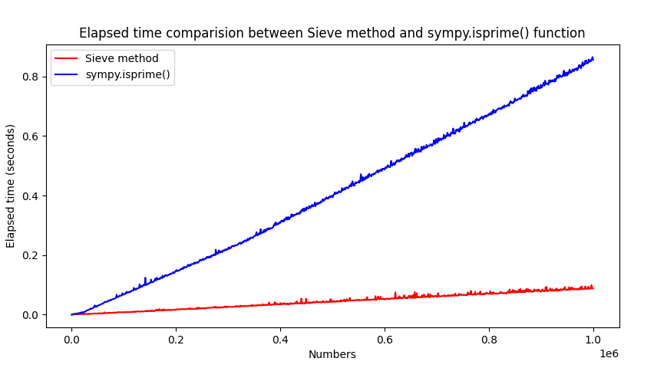

Slide 7
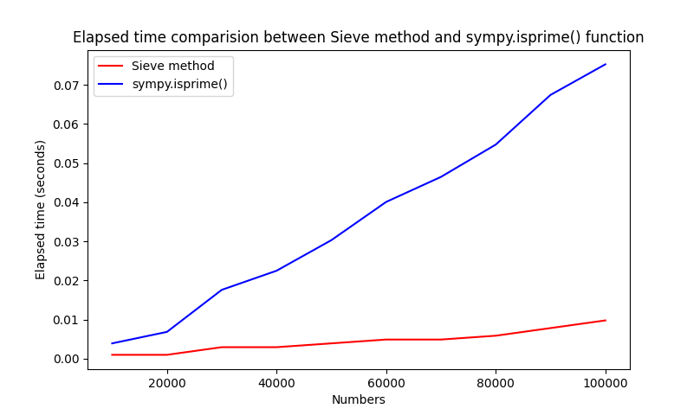
Number: 10000
Elapsed time for sieve method: 0.0009772777557373047
Elapsed time for sympy.isprime() function: 0.003908634185791016
Number: 20000
Elapsed time for sieve method: 0.000978231430053711
Elapsed time for sympy.isprime() function: 0.0068399906158447266
Number: 30000
Elapsed time for sieve method: 0.002931356430053711
Elapsed time for sympy.isprime() function: 0.017588376998901367
Number: 40000
Elapsed time for sieve method: 0.002931356430053711
Elapsed time for sympy.isprime() function: 0.022474050521850586
Number: 50000
Elapsed time for sieve method: 0.0039081573486328125
Elapsed time for sympy.isprime() function: 0.030291318893432617
Number: 60000
Elapsed time for sieve method: 0.004885673522949219
Elapsed time for sympy.isprime() function: 0.040062665939331055
Number: 70000
Elapsed time for sieve method: 0.004885435104370117
Elapsed time for sympy.isprime() function: 0.046460866928100586
Number: 80000
Elapsed time for sieve method: 0.005862712860107422
Elapsed time for sympy.isprime() function: 0.05471968650817871
Number: 90000
Elapsed time for sieve method: 0.00781702995300293
Elapsed time for sympy.isprime() function: 0.06742286682128906
Number: 100000
Elapsed time for sieve method: 0.009771585464477539
Elapsed time for sympy.isprime() function: 0.07523965835571289

Slide 8
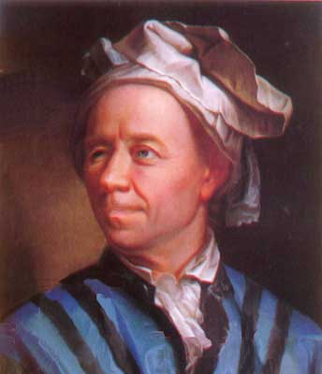
Goldbach’s Weak Conjecture
“Every odd number greater than 5 can be expressed as the sum of three primes.”
“Every odd number greater than 7 can be expressed as the sum of three odd primes.”
Proven in 2013 by Harald Helfgott, a Peruvian mathematician.
Christian Goldbach
(18 March 1690 – 20 November 1764)

Slide 10
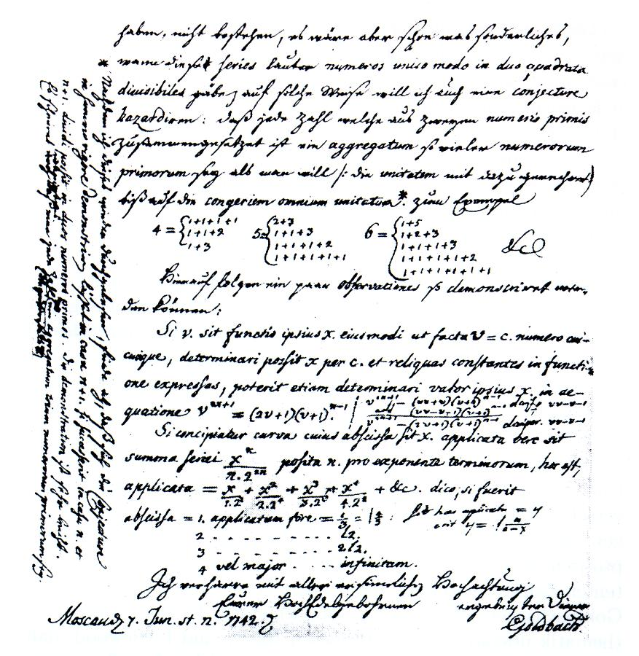

Goldbach’s Strong Conjecture
“Every natural even number greater than two is the sum of two prime numbers.”
T. Oliveira e Silva ran a distributed computer search that has verified the conjecture up to $4×{10}^{18}$ and double-checked up to $4×{10}^{17}$ in 2013.
Letter from Goldbach to Euler
dated on 7 June 1742 (Latin-German)

